Slide 1

SWL is not died
Still effective - Still active
Kemal SARICA M.D.
Professor of Urology
Department of Urology
Biruni University, Medical School

Slide 2
Evidence Based Treatment of Renal Stones
Good stone doctors use both individual clinical expertise and the best available external evidence
Neither alone is enough !!
Without clinical expertise, practice risks becoming tyrannised by evidence
Even excellent external evidence may be inapplicable to or inappropriate for an individual patient !!
Without current best evidence, practice risks becoming rapidly out of date, to the detriment of patients
Sackett et al. BMJ 1996; 312: 71.

Slide 3
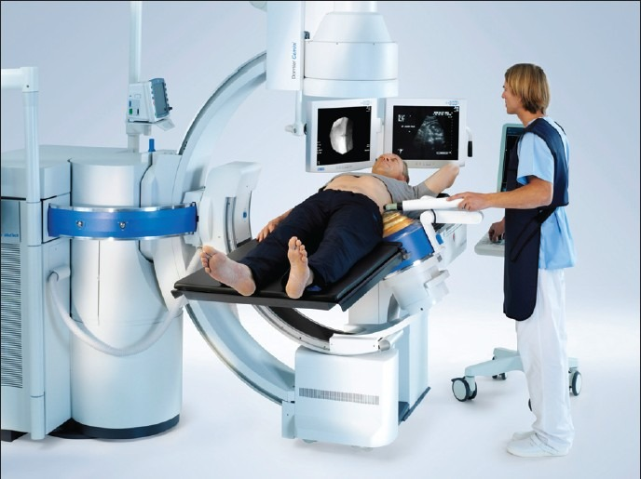
Management of urinary stones...
SWL: The only noninvasive option..

Slide 4
Application rates….
Are they really decreasing?

Slide 5
Stone management
1990 -2000
A detailed medline search
A 75 % increase in all stone removal procedures
Parallel to this increase SWL application has also increased around 60 %
Lingeman JE et al., Nat.Rev. Urol.; 2009

Slide 6
SWL vs URS in clinical practice
“American Urological council” originated “urologic surgery certifications” were investigated
Of all certifications given; while surgeons did prefer URS in 54 % of the cases in the beginning, 60.5 % of all surgeons ( particularly the experienced ones) did prefer SWL in the beginning.
Matlaga BR et al., J. Urol.; 2009.

Slide 7
Stone Tx : Variation of the techniques used Scales CD et al.; J.Urol.; 186(1);146,2011.
Changes in Tx philosophy between 1997 –2007
Particularly SWL vs URS
A total of 9358 cases
SWL : Primary choice in 5208 cases (56 %)
URS : First choice in 4150 cases (44 %)
URS procedure was more common in female cases (OR 0.844, p = 0.006)

Slide 8
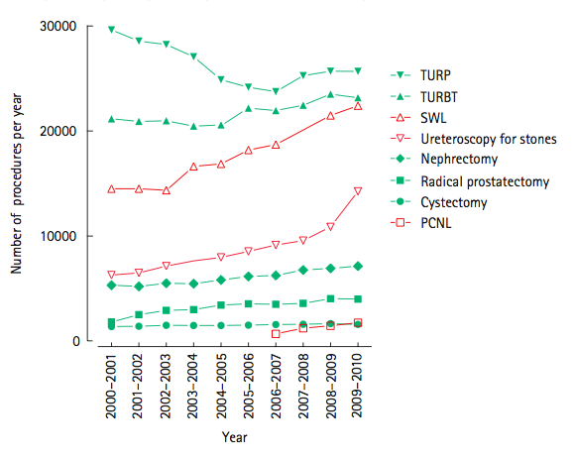
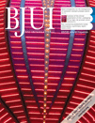
Trends
Notes:
The use of shock wave lithotripsy (SWL) for treating all upper tract stones increased from 14491 cases in 2000–2001 to 22402 cases in 2010 (a 55% increase) with a 69% increase in lithotripsy for renal stones.

Slide 9
How about success rates?
Are they significantly low and unacceptable?

Slide 10
SWL
Stone free rates
% Stone Free
Lingeman and Newman, 1990

Slide 11
SWL
Size related success rates
  <15mm 15-29mm >30mm
  Multiple SWL 5 % 10 % 15-30 %
  Stone-free rate > 80 % 60 % 50 %
  Auxiliary procedures 2 % 5-7 % 15 %
  Repeat procedures 1-2 % 10-15 % 15-20 %

Slide 12
Stone size and stone free rates
66.819 patients
J Endourol 2008
Taş Boyutu | SFR
1-10 mm | % 88
11-20 mm | %75
21-30 mm | % 40
> 30 mm | % 29

Slide 13
Stone Tx – My department
01.04.2018 - 01.04.2019
Procedure n %
SWL 845 51.7
URS 411 25.1
PNL 362 22.1
Open 14 1.1
Total 1769 100

Slide 14
Endourological management of stones
Stone free rates – primary treatment (Renal Pelvis)
 | ESWL | RIRS | PCNL | UMP
Number of patients | 4682 | 282 | 2242 | 64
SFR | 81 % | 87 % | 94% | 94%

Slide 15
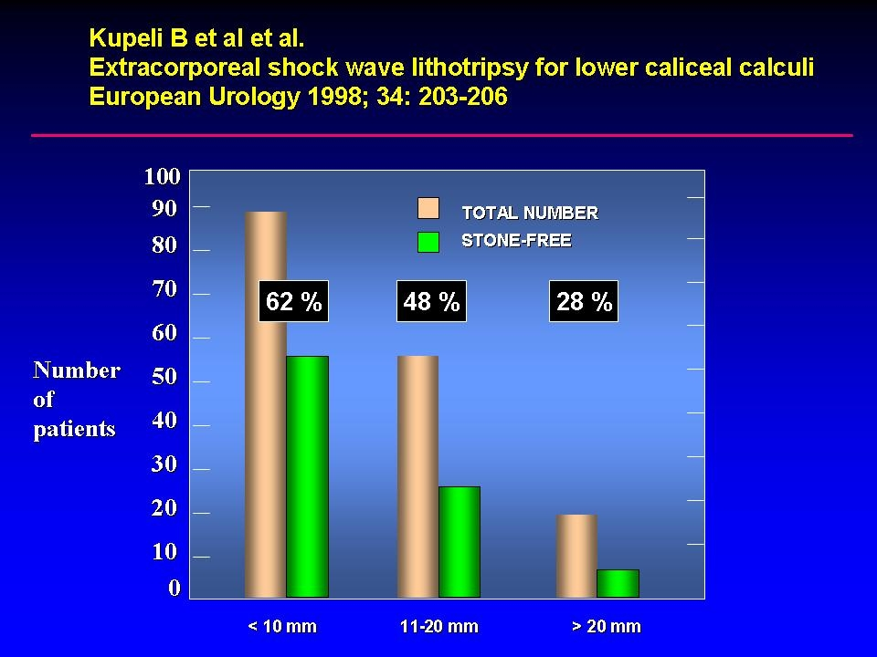

Slide 16
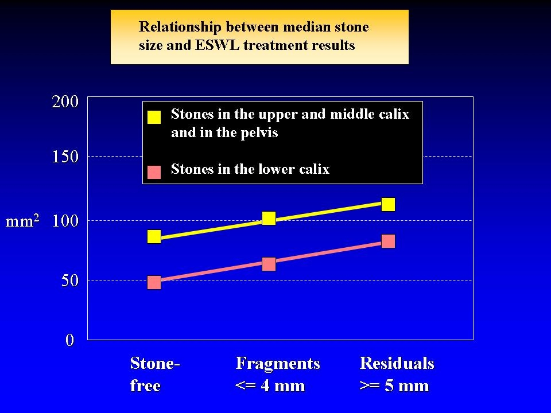

Slide 17
Higher SF rates.. At the expense of what ?
RIRS and PNL may provide comparable SF rates in moderate sized renal stones
Although PNL is effective, the most prominent drawback is its invasiveness and patient discomfort
Blood loss, radiation exposure, hospital stay, and morbidities of PNL can be significantly reduced with RIRS technique

Slide 18
What about complications compared to other available alternatives ?

Slide 19
Endourological management of stones
Complications
 | ESWL | RIRS | PCNL | UMP
Sepsis | 3 % | 4 % | 5% | 3%
Steinstrasse | 5 % | 0 % | 0% | 0%
Stricture | 2 % | 2 % | 0% | 0%
Ureteral injury | 0 % | 6 % | 0.5% | 0%
UTI | 3 % | 5 % | 6% | 5%
Bleeding | 0% | 0% | 8% | 2%
Urinary leak | 0% | 0% | 3% | 0%

Slide 20
Endourological management of stones
Secondary procedure rates
 | ESWL | RIRS | PCNL | UMP
Number of patients | 22% | 74% | 8% | 5%

Slide 21
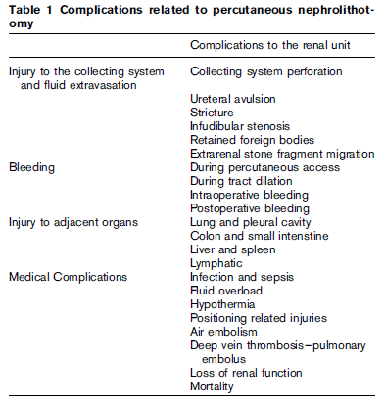
PNL - Complications

Slide 22
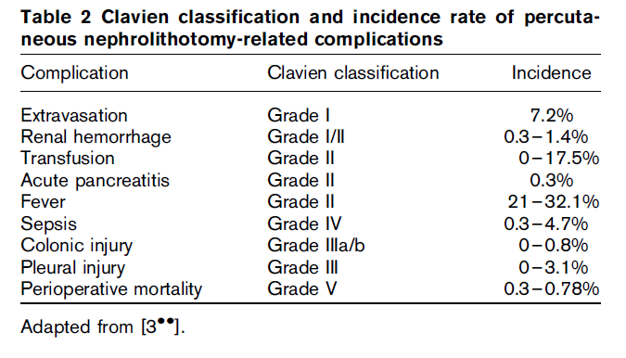

Slide 23
Complications of RIRS
A meta-analysis published by the EAU-AUA
  Sepsis
  Steinstrasse
  Stricture
  Ureteric injury
  Urinary tract infection
The overall complication rates : 5 - 9%
Significant complications1 rate : 1 %
Renal loss and death were rare

Slide 24
POSSIBLE COMPLICATIONS
Intraoperative
Mucosal abrasion
False passage
Ureteral perforation
Extravasation
Ureteral avulsion
Thermal injury
Intussusception
Equipment malfunction
Difficult access
Early postoperative
Infection
Clot retention
Steinstrasse
Edema
Urinary retention
Late postoperative
Vesicoureteral reflux
Stricture
Avascular ureteral necrosis

Slide 25
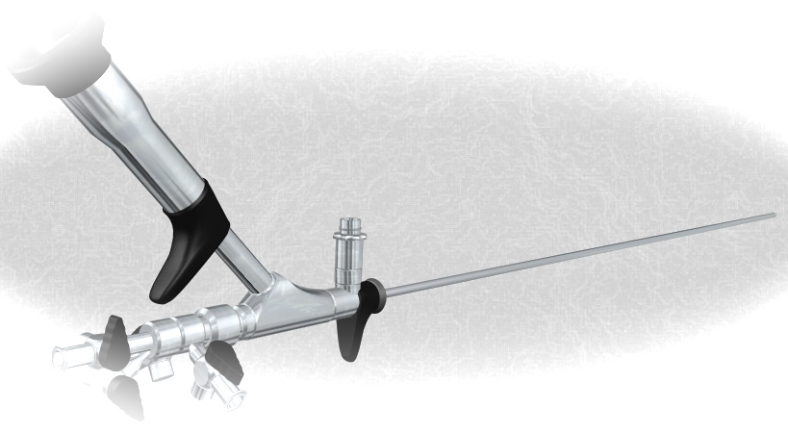
Rigid and flexible URS are safe
Intraoperatively: 3.6 %
Mucosal injury 1.5%
Ureter perforation 1.7%
Significant bleeding 0.1%
Ureteral avulsion 0.1%
Early complications: 6 %
Fever or Urosepsis 1.1%
Persistant hematuria 2.0%
Renal colic 2.2%
Late complications: 0.2 %
Ureteral stricture 0.1%
Persistant VUR 0.1%
Geavlete et al. J Endourol 2006 (2,700 patients)

Slide 26
Good clinical practice: Improving the success rate

Slide 27
Improving the outcomes of SWL
A well performed pre-operative imaging
An adequate pain management
Lowering stone movement by an abdominal compression belt
Observation and avoidance of every interference between the shock wave path
A proper acoustic coupling (Opticouple – Delta III)
Lowering the frequency rate (60-90/min)
Energy level adjustment (stepwise increase)
Use of sole USG for a certain per cent of kidney stones !!

Slide 28
Supportive therapy
Medical therapy
Medical expulsive therapy (MET) with
● calcium channel blockers
● oral corticosteroids
● α-channel blockers
is effective for the treatment of small lower ureteric stones and as
adjunctive medical therapy after ESWL
Gravina et.al. (2005)
130 patients with solitary renal stones until 20 mm underwent single ESWL
● 78,5 % clinical success for ESWL + MET
● 60 % clinical success for ESWL alone
!
MET augment stone passage, reduce the time of
Stone expulsion and lowers the need of analgesia

Slide 29
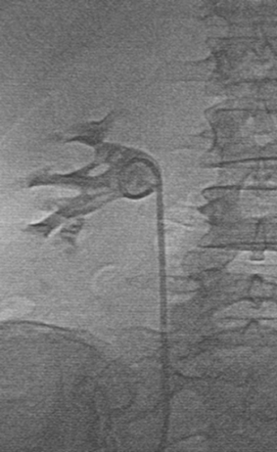
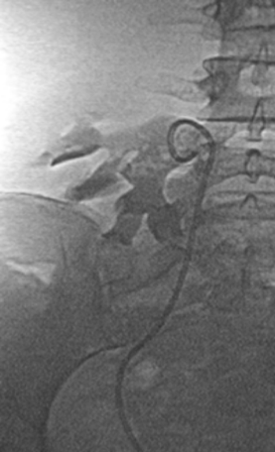
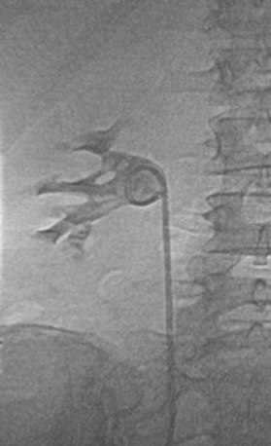
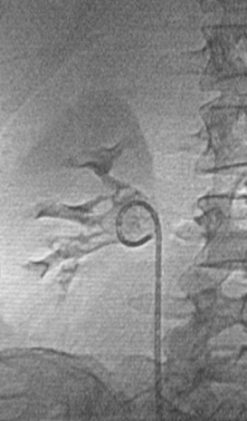
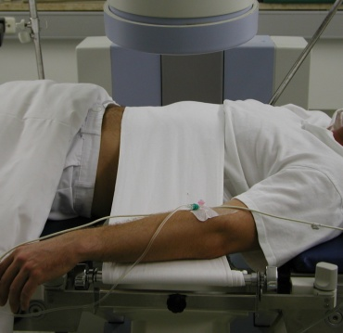
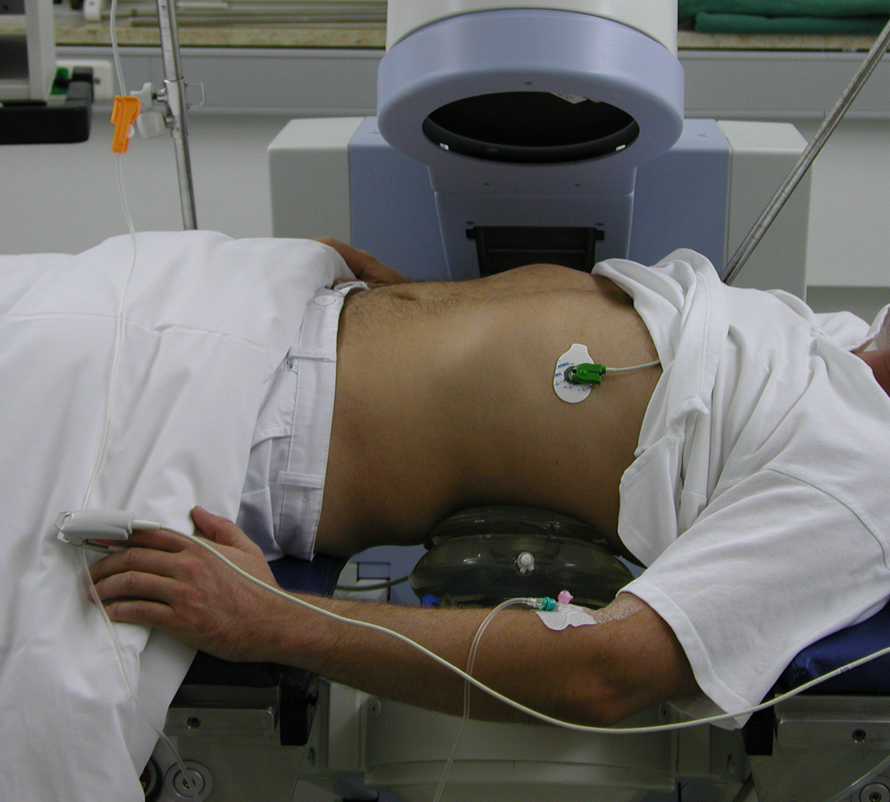
Patient fixation
Abdominal compression
without compression
exspiration
inspiration
Low hit rate
efficacy
with compression
exspiration
inspiration
movements
Increased
hit rate
!
patient fixation and abdominal compression enable higher target stability
Better stone fragmentation + reduced side effects

Slide 30
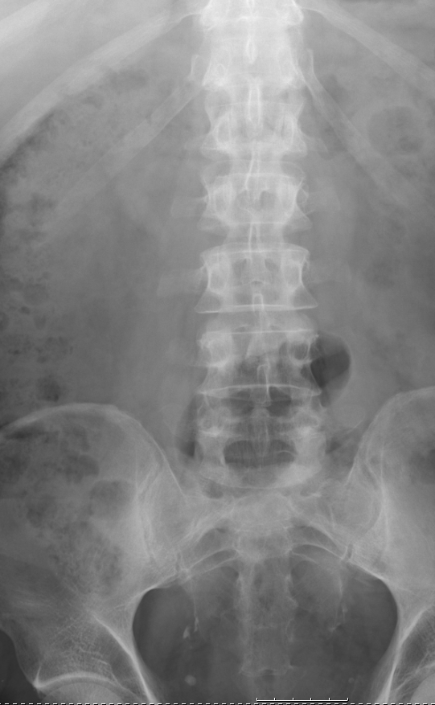
Observe and avoid every interference between the shock wave path and skeletal structures and intestinal gas !!

Slide 31
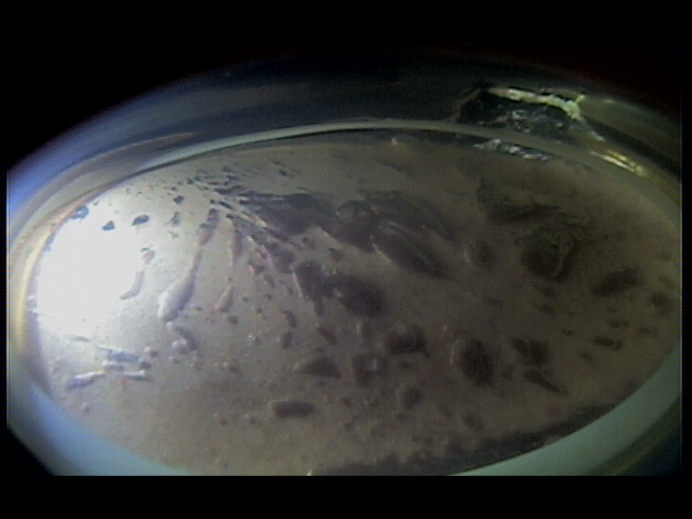
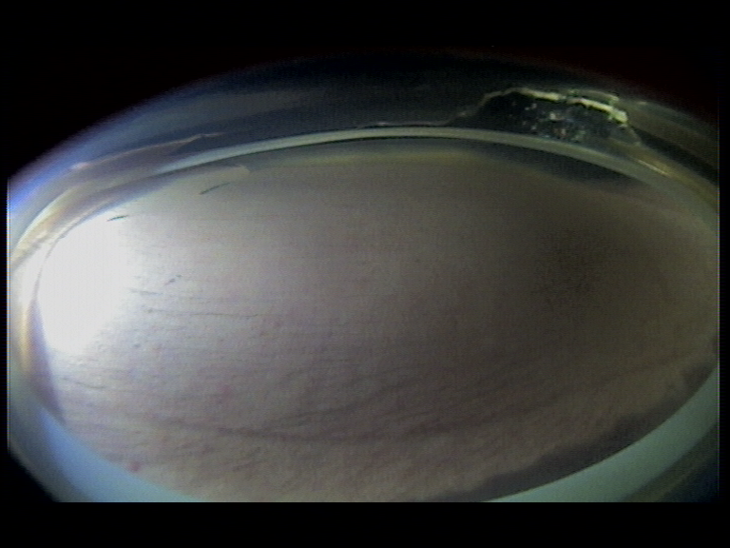
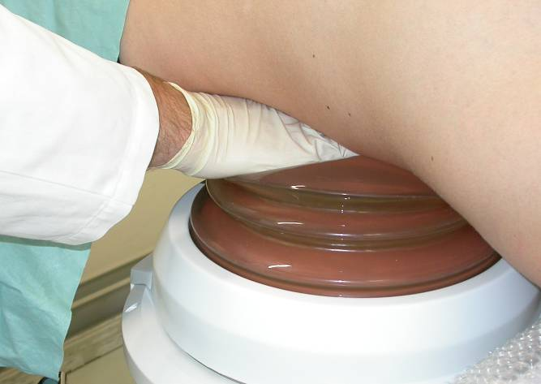
Coupling of SW-source
Coupling with inclusion of air bubbles
Bubble-free coupling
Manual removal of air bubbles by swiping

Slide 32
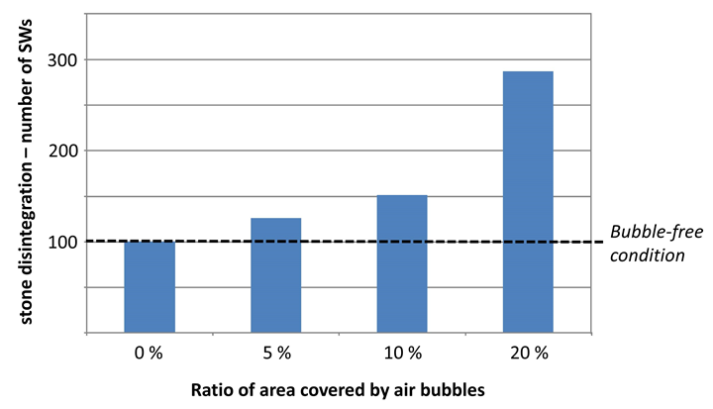
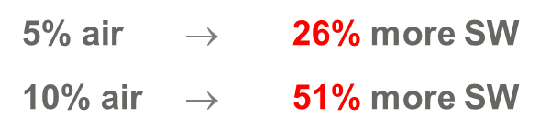
Dornier Delta III – OptiCouple
Enhances treatment efficiency
USP!

Slide 33
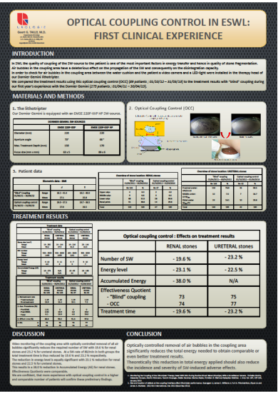
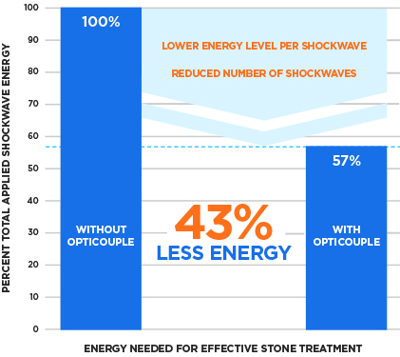
Dornier Delta III – OptiCouple
USP!
Enhances treatment efficiency
To achieve the same ESWL Effectiveness Quotient (EQ), OptiCouple helps in:
Reduction in energy level
Reduction in number of shock waves
Reduction in treatment time
Tailly GG, Tailly-Cusse MM: “Optical Coupling Control:
An Important Step Toward Better Lithotripsy”, J Endourol (2014) 28(11):1368-73.

Slide 34
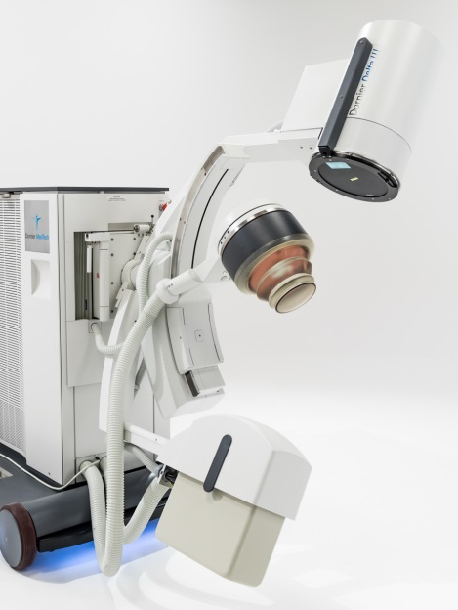
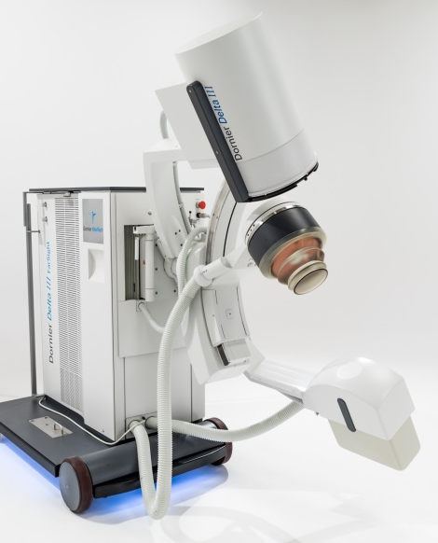
Localization and Imaging
Integrated X-Ray C-arm
No alignments required
CC+ and CC- imaging direction
Fully motorized movements
Remote controlled
9” image intensifier
Rotating anode

Slide 35
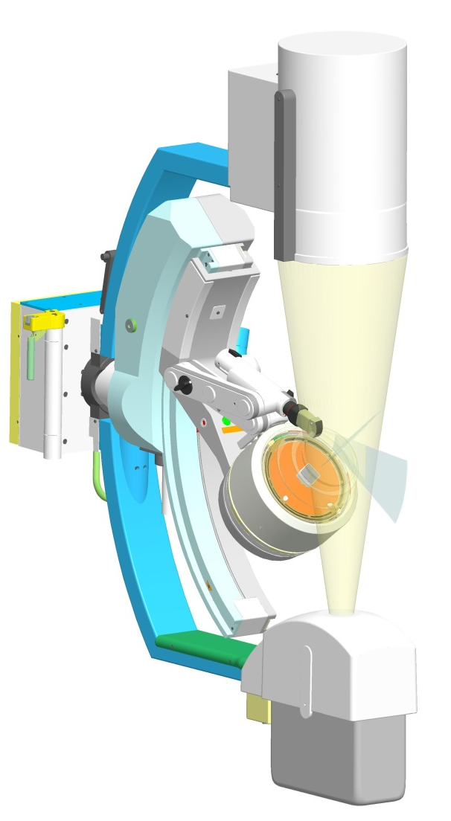
Localization and Imaging
Tri-Mode Imaging
Unique feature in midrange and high-end
lithotripters
Isocentric US provides much better image
quality than any inline US and unsurpassed
imaging flexibility on the kidney
FarSight provides best imaging access to
distal ureteric stones and stones in the
biliary system
Both US imaging systems do not interfere
with shock waves
Either US imaging system can be applied
with fluoroscopy for dual imaging

Slide 36
Optivision: Another signifcant advantage
The software utilizes multi-frequency processing to significantly enhance image quality compared to standard urology images used so far.
Provides the chance to identify and eliminate stones without cumbersome manual post-processing with essentially sharp image details and comfortable reading
This parameter will enable to strike an optimal balance between low radiation dose and high image quality, serving as a powerful tool in the management and potential reduction of patient radiation dosage in imaging procedures.

Slide 37
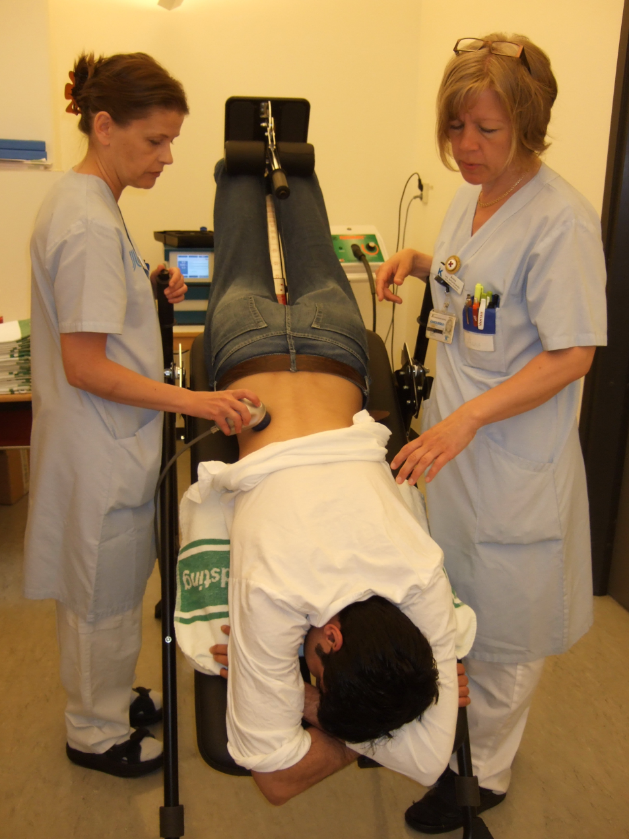
Supportive therapy
Physical measures
Physical measures like
● Mechanical percussion P
● Diuresis D
● Inversion I
Facilitates passage of stone debris from the lower pole collecting system
Chiong et.al. (2005)
108 patients with lower pole stones until 20 mm treated with ESWL
● 62,5 % stone clearance for ESWL + PDI
● 35,4 % stone clearance for ESWL alone
!
PDI is an easy tool for the improvement of ESWL results
And don‘t
forget
Metaphylaxis with potassium citrate in calcium oxalate
stone formers can reduce recurrence rate after ESWL

Slide 38
Hardness factors values for different stone components
4
3
1.3
1.0
2.2
1.1
1.0
2.4
1.0
2
1
0
COM COD BRU HAP INF CY UA
Ringdén I, Tiselius HG.
Composition and clinically determined hardness of urinary tract stones
.Scand J Urol Nephrol. 2007;41:316-23.

Slide 39
Are there any additional advantages of SWL?

Slide 40
SWL in children
Advantages
Children pass stones fragments well and do not require routine stenting
IV sedation may allow Tx in select older children
Newer generation lithotriptors with smaller focal zones allows less painful SWL
Better stone fragmentation
- Shorter duration of stone disease
- Greater stone fragility
- Lower impedance to shock waves

Slide 41
Emergency SWL
An interesting current concept
When ESWL was used in the first 6 h after the onset of renal colic (as long as ureteric peristalsis is not yet reduced due to obstruction) excellent SFR were reported

Slide 42
Emergency ESWL for Ureteral Stones
  Single radio-opaque ureter/ PUJ stones < 1.5cm
  Obstruction, No infection
  Treated within 24-48 hours
  Limited or no impaction / oedema ( High success)
  Convenient fluid chamber ( Easy disintegretion)
  Quick elimination of obstruction & pain
  Rapidly improve kidney function
  Shorten hospital stay and days off-work
  Limited or no patient discomfort

Slide 43
SWL
Well known advantages
No general or regional anesthesia
Ambulatory treatments
Minimal or no risk of complications
Practicle and repeated applications

Slide 44
What do the guidelines ( Evidence based data) tell us?

Slide 45
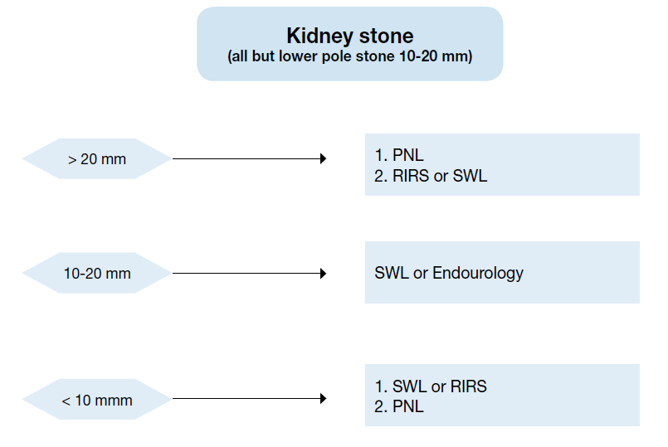
EAU guidelines 2019

Slide 46



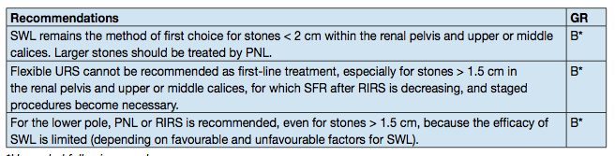

KIDNEY CALCULI
What are the trends in kidney stone management?

Slide 47
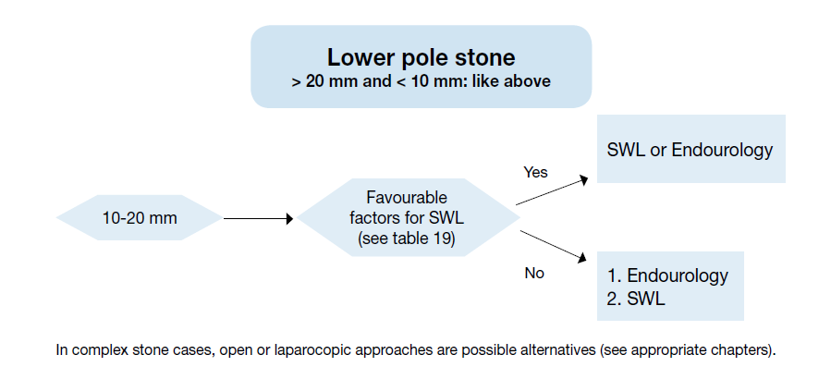
EAU guidelines 2019

Slide 48
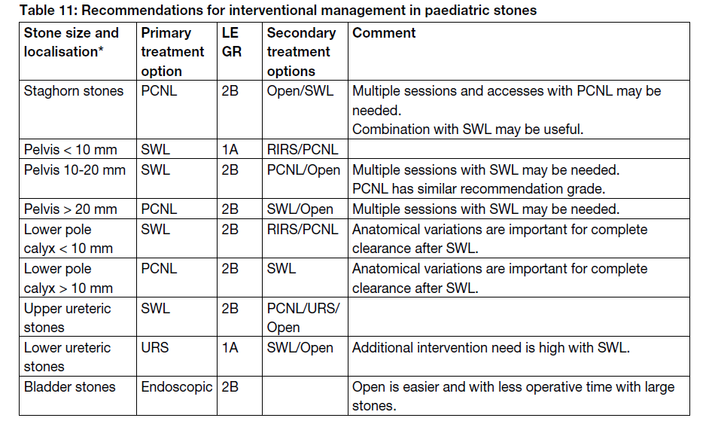

Slide 49
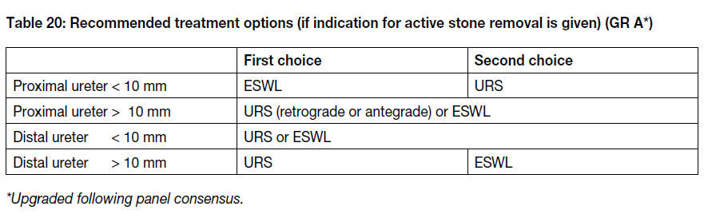

Slide 50
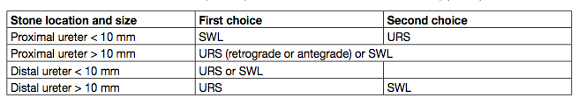
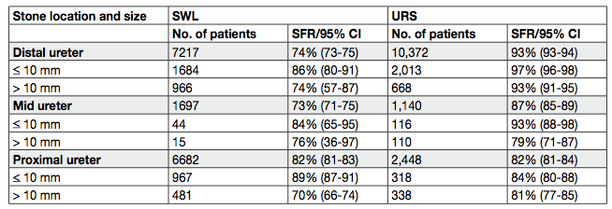
URETERAL CALCULI
Preminger et al. Eur Urol 2007; 52; 1610-31.

Slide 51
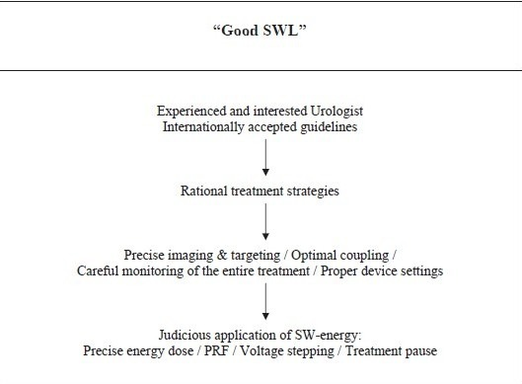
Good SWL ( G. Tailly )

Slide 52

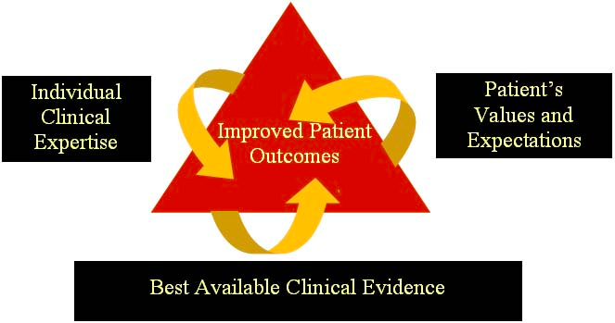

Slide 53
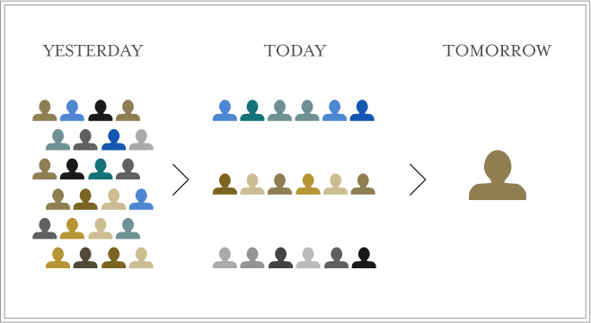
PSA: PERSONALIZED STONE APPROACH

Slide 54
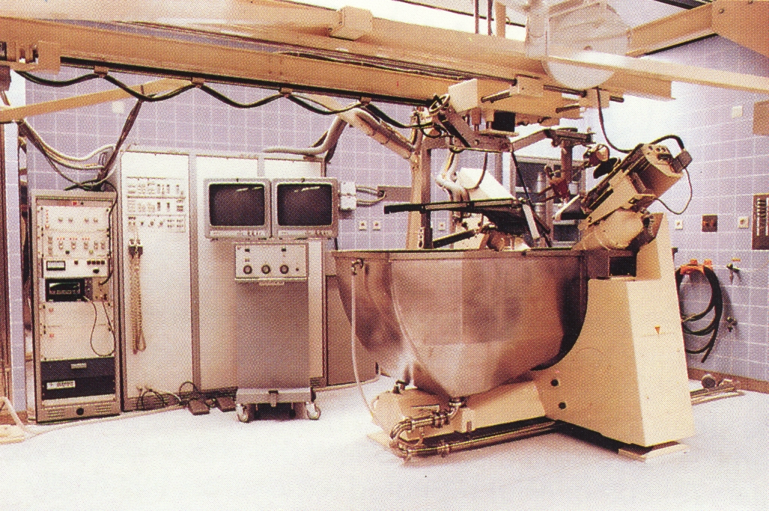
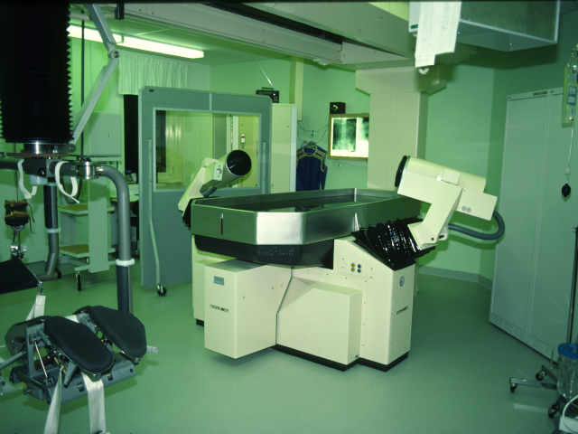
After 35 years !!
DORNIER
LITHOTRIPTER HM 1
SWL is still the only non-invasive surgical procedure !!

Slide 55
Conclusions - 1
As a result of promising new technical developments SFR after ESWL will certainly increase and treatment will be safer and more comfortable
Current indications need to be refined on a stone ( size, location and hardness) and patient ( BMI, anatomical abnormalities etc) related factors based manner.

Slide 56
Conclusions -2
For optimal results the refined indications need to be respected and optimised treatment protocols should be applied
Necessary precautions along with a certain level of experience will let us to perform SWL in a safe and successful manner in moderate sized stones as an excellent alternative to the other endourological procedures...

